Slide 1

Pitney Bowes Calculator Initial Design

Slide 2
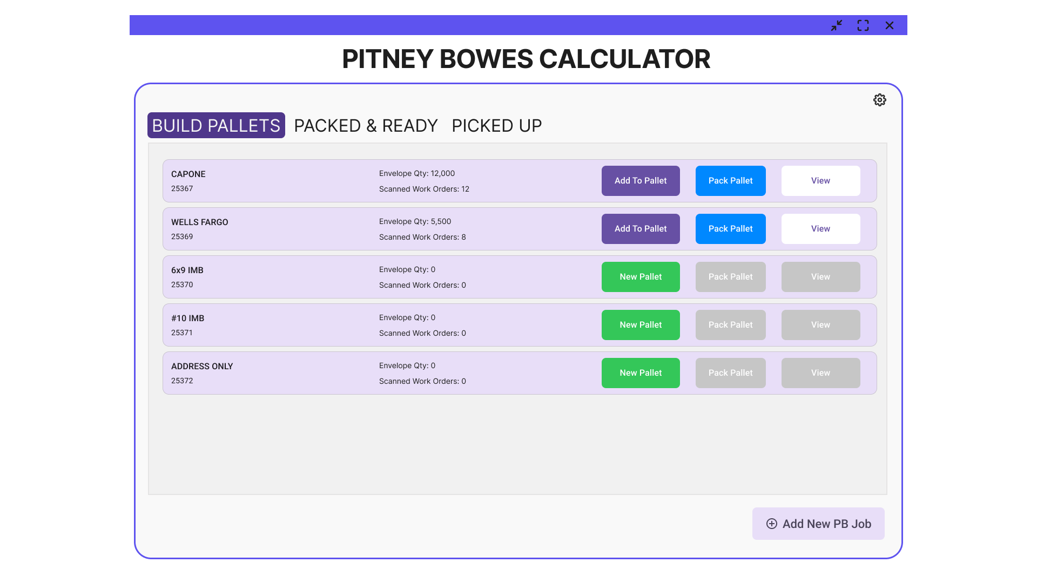
Notes:
Main Iinterface
- Build Pallets
- Packed & Ready
- Picked Up

Slide 3
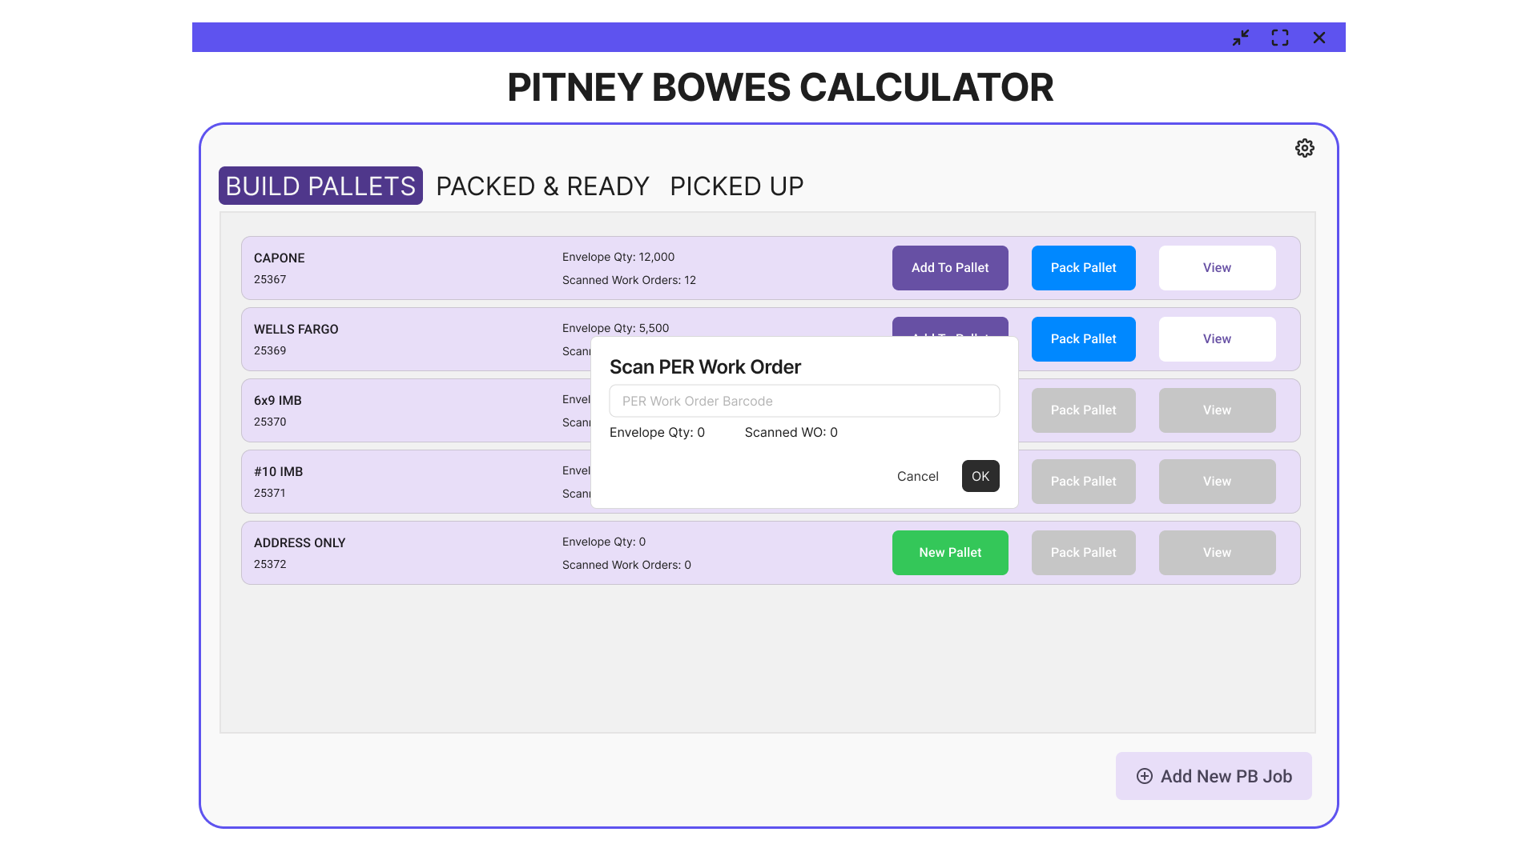
Notes:
Building New Pallet - New Pallet
When WO Barcode scanned, should automatically search into CPS DB to get the envelope quantity.
Envelope Qty field adds up all the scanned WO.

Slide 4

Notes:
Add to Pallet - can continue scanning of WO to be added to the pallet

Slide 5

Notes:
Pack Pallet - user manually count the trays in the pallet and put the quantity once Pack Pallet clicked.

Slide 6
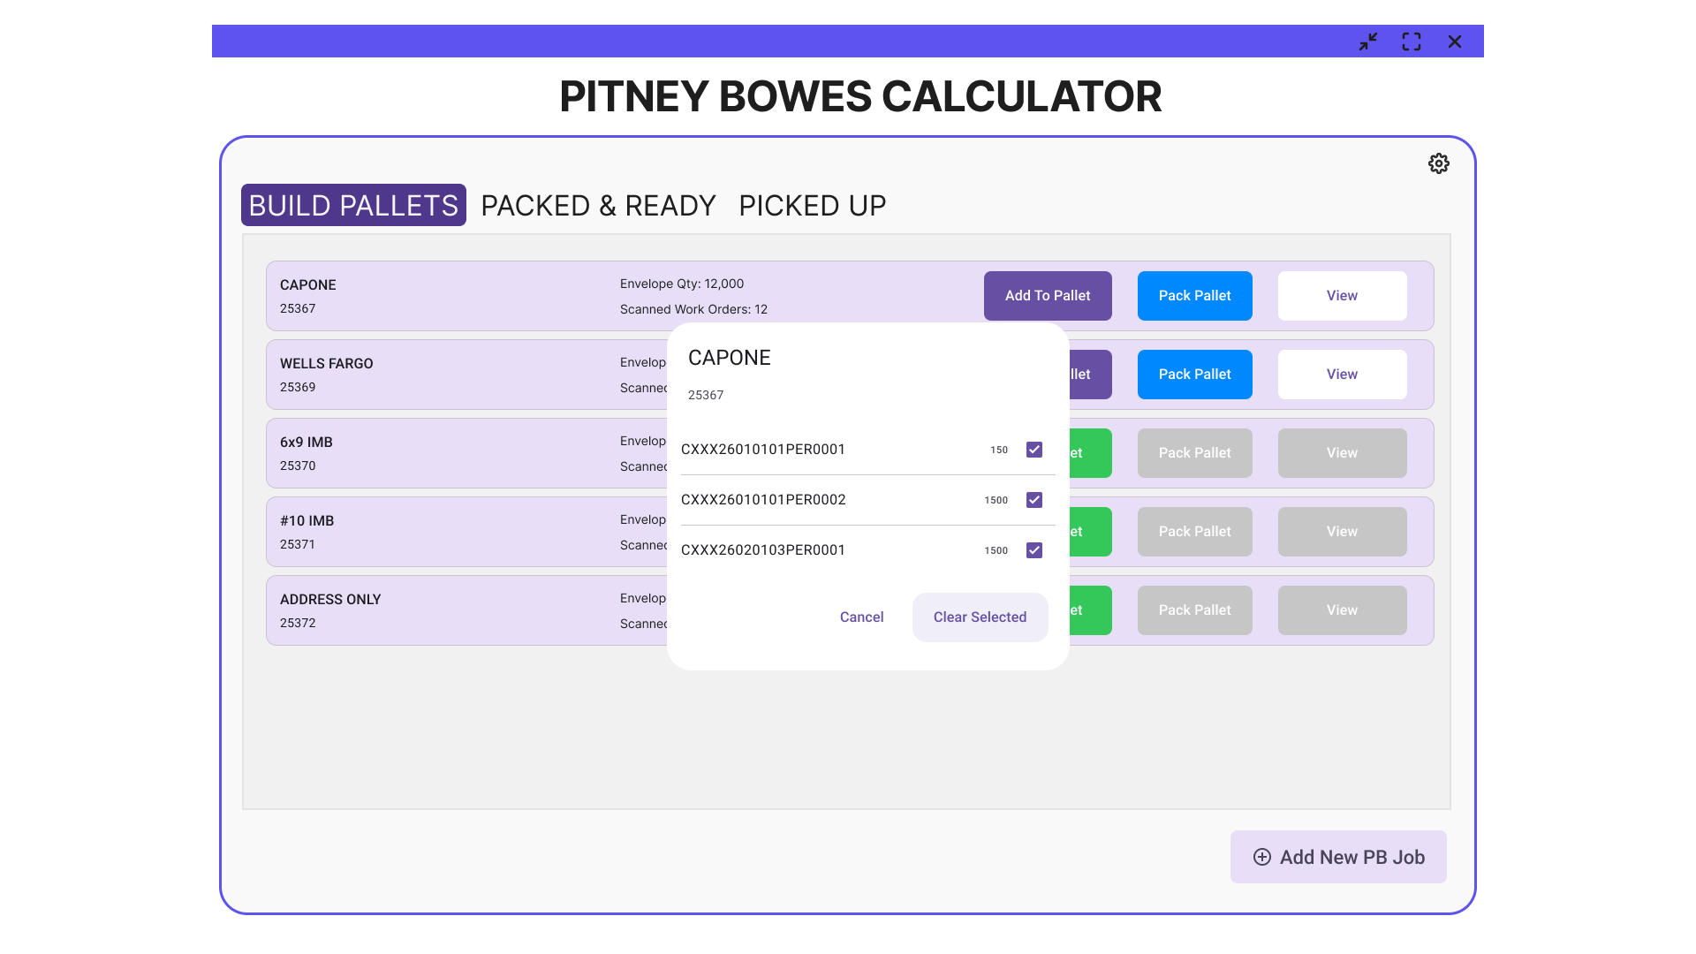
Notes:
View - list of all the scanned WO and envelope quantity for each WO. User can select WO to remove from pallet.

Slide 7
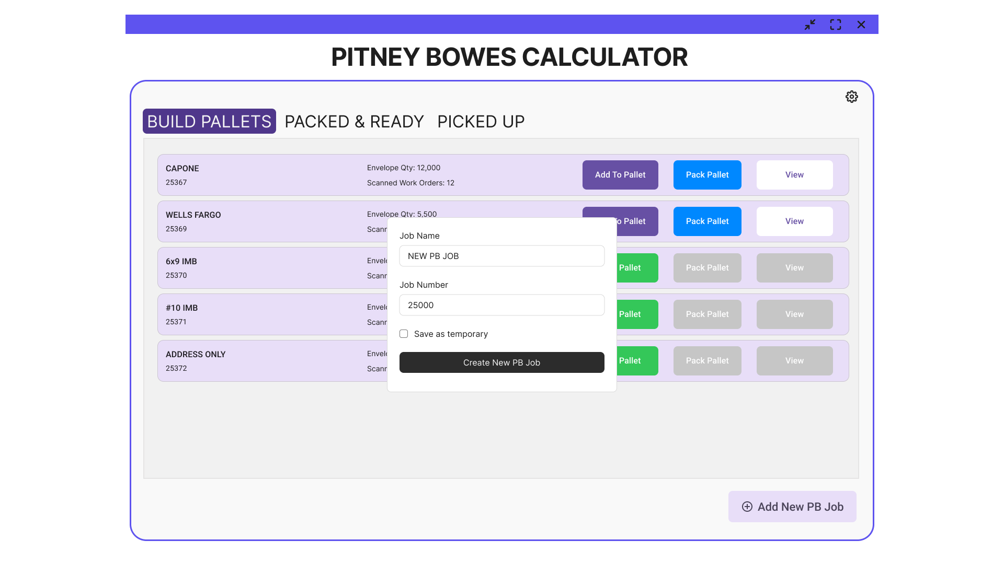
Notes:
Add New PB Job - can be save as temporary for special cases. By default (save as temporary unchecked), should save permanently to the tool's DB.

Slide 8
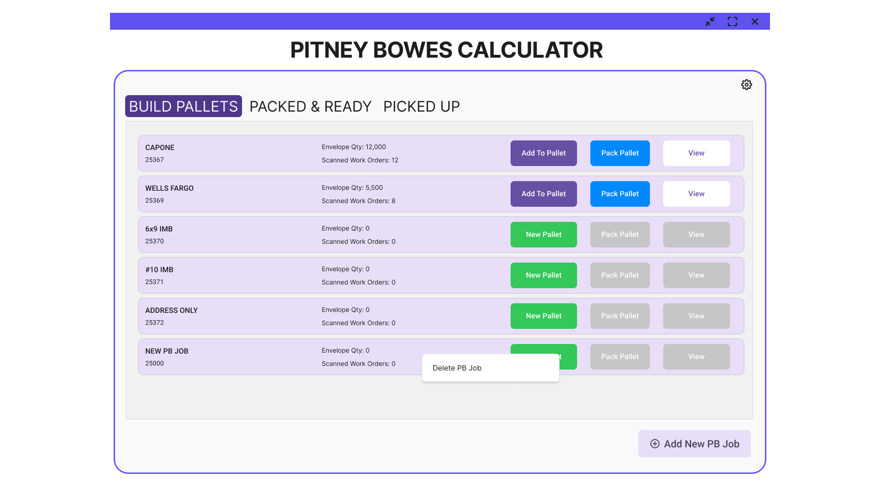
Notes:
A contextual menu - right click on the PB Job card to be able to delete it from the list.

Slide 9
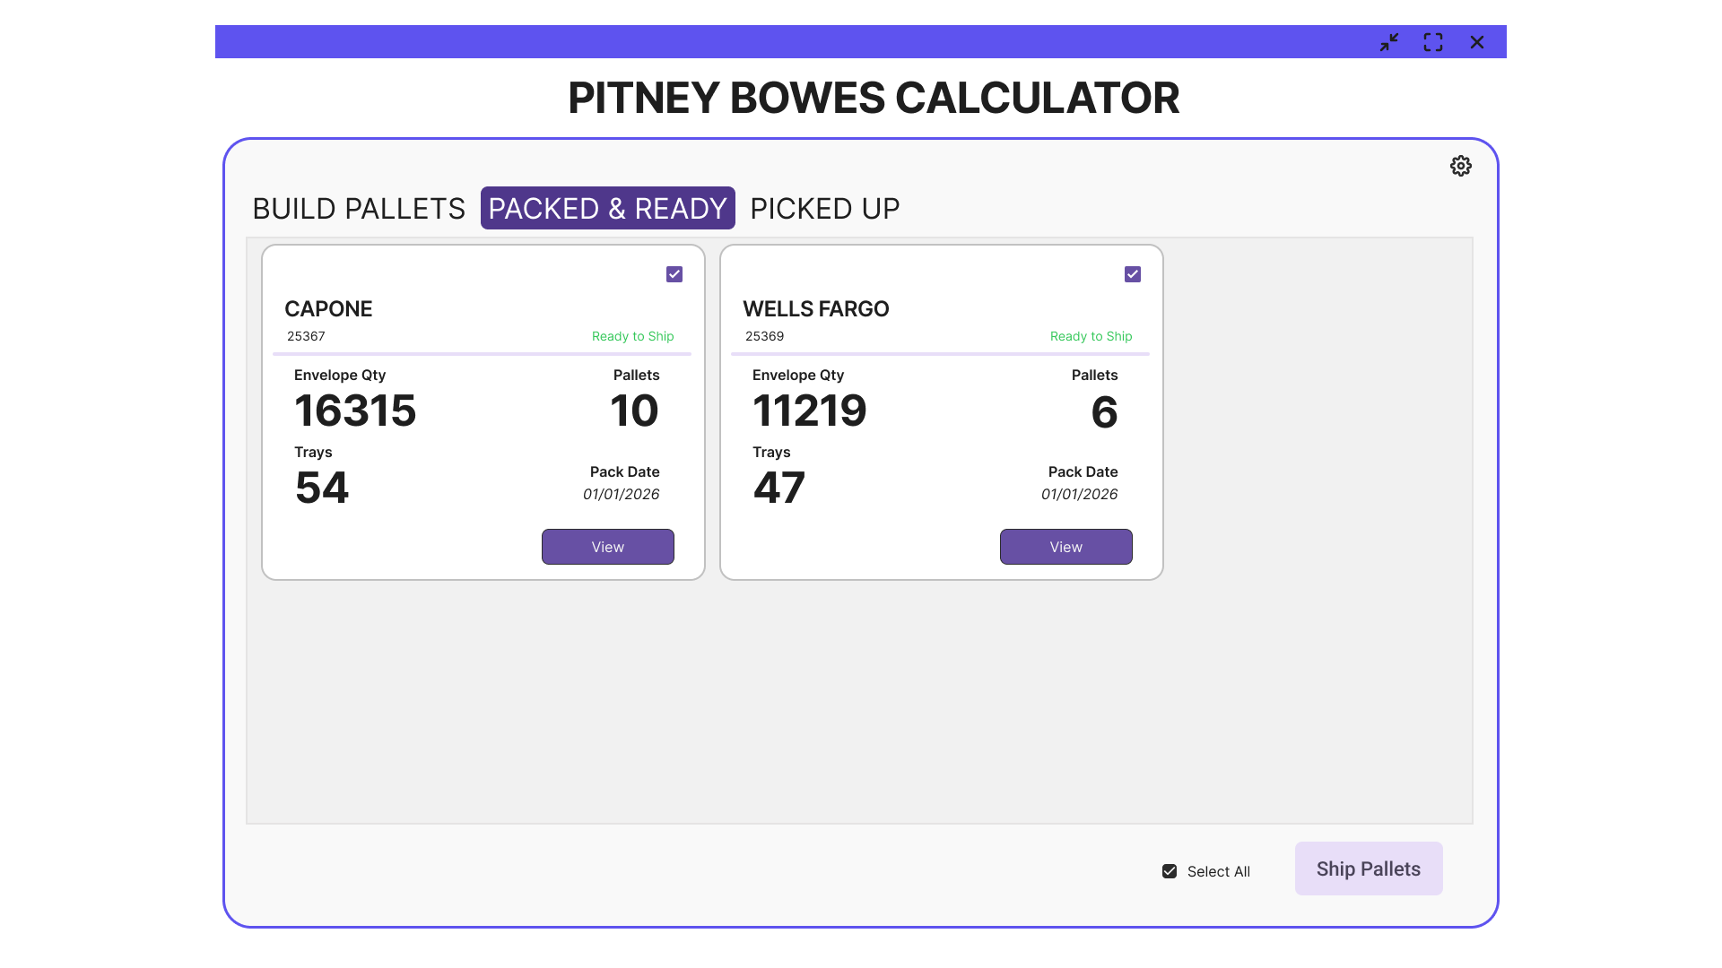
Notes:
Shows the list of PB Job and total qty of Envelope, Trays and Pallets for each PB Job.

Slide 10

Notes:
User can set the PB Job and its pallets to 'Not Ready' state.
Ship Pallets should only ship the PB Jobs that is ready to ship.

Slide 11
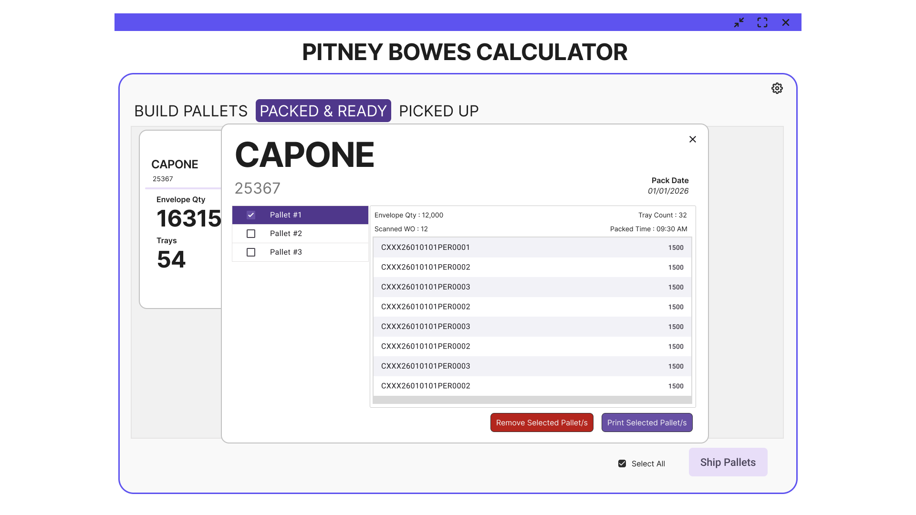
Notes:
Clicking View on a PB Job will display all packed pallets along with their pallet details. Use the checkbox next to a pallet to remove it or print that specific pallet.

Slide 12
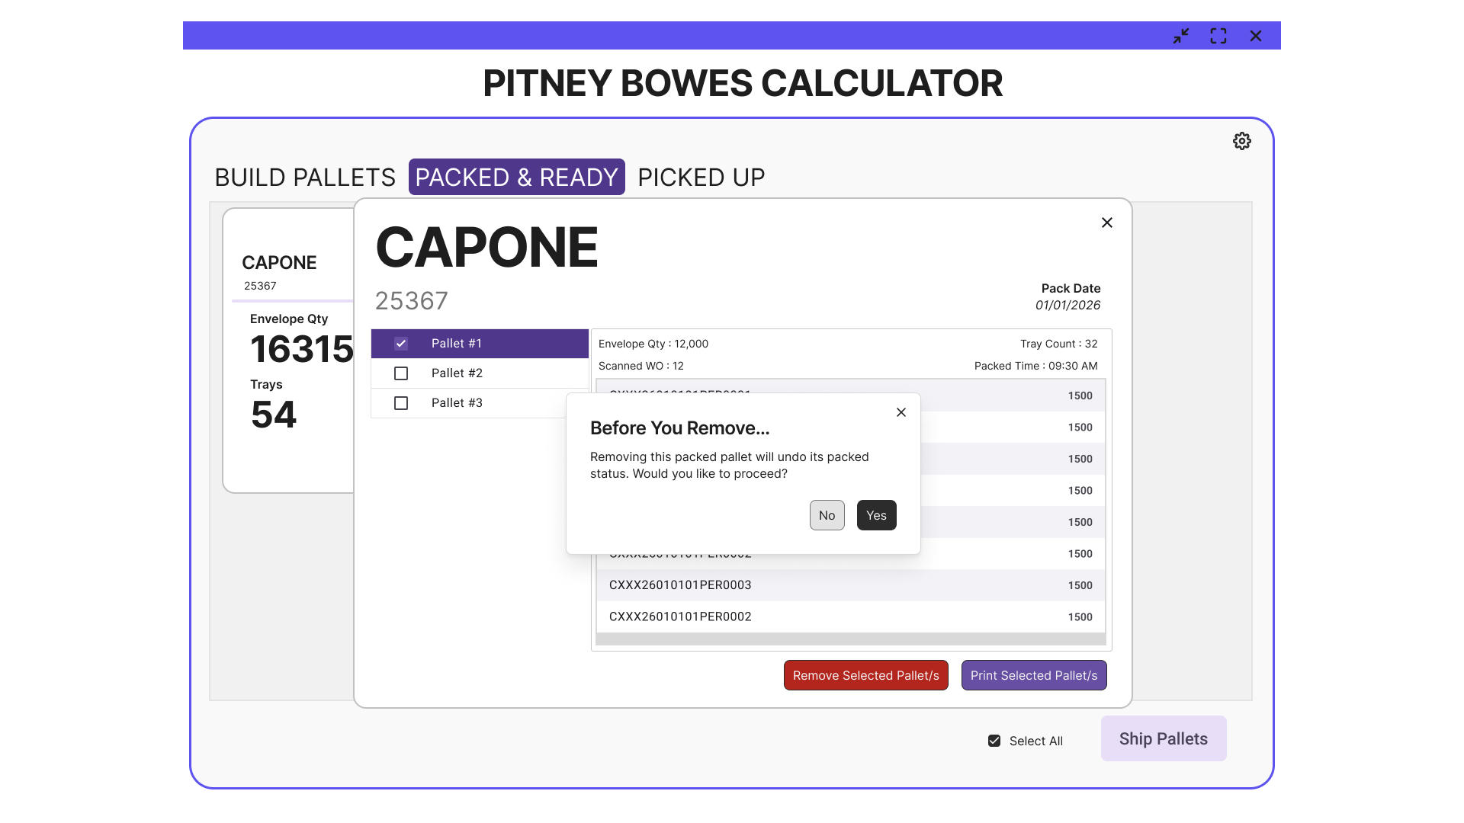
Notes:
Confirmation message before removing a Packed Pallet from the PB Job.

Slide 13
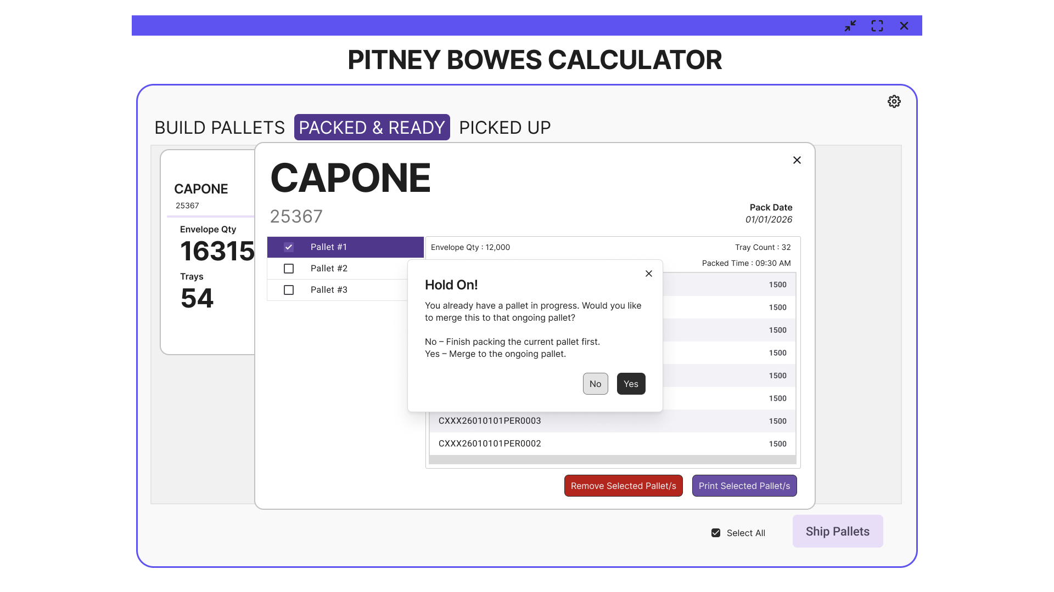
Notes:
The tool will first check if there’s an active pallet on this PB Job before allowing you to remove a packed pallet. Yes – Merge the scanned WO from the packed pallet into the active pallet. No – Continue working on the current active pallet instead.

Slide 14
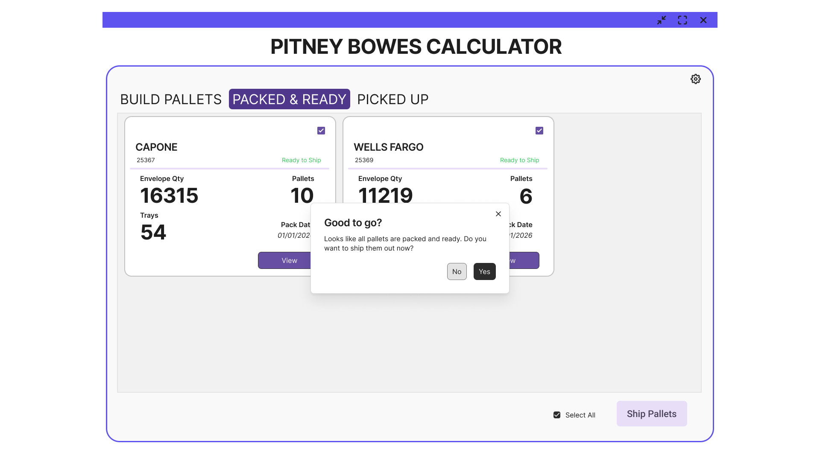
Notes:
Confirmation message before marking all pallets as Picked Up/Shipped. After the user confirms, this screen will be cleared.

Slide 15
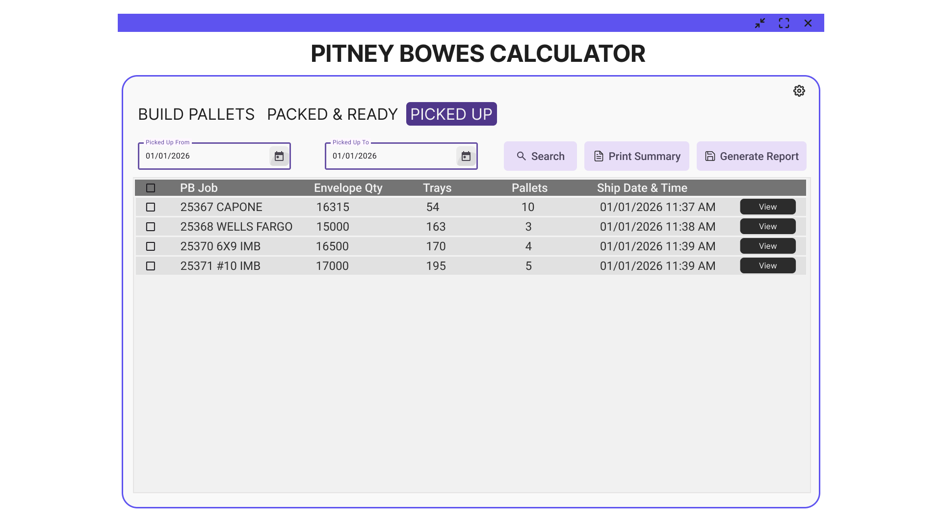
Notes:
Displays all PB Jobs with total envelope quantities, trays, and pallets based on the selected date filter. Print Summary – Reprints the PB Summary Report for a specific date and time. Note: AM and PM summaries cannot be combined into a single report. Generate Report – Exports the list to a CSV or Excel file.

Slide 16
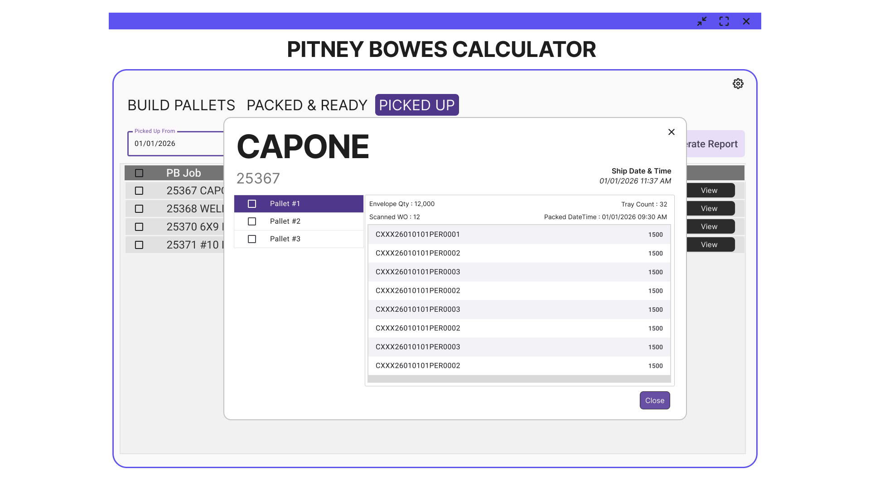

Slide 17
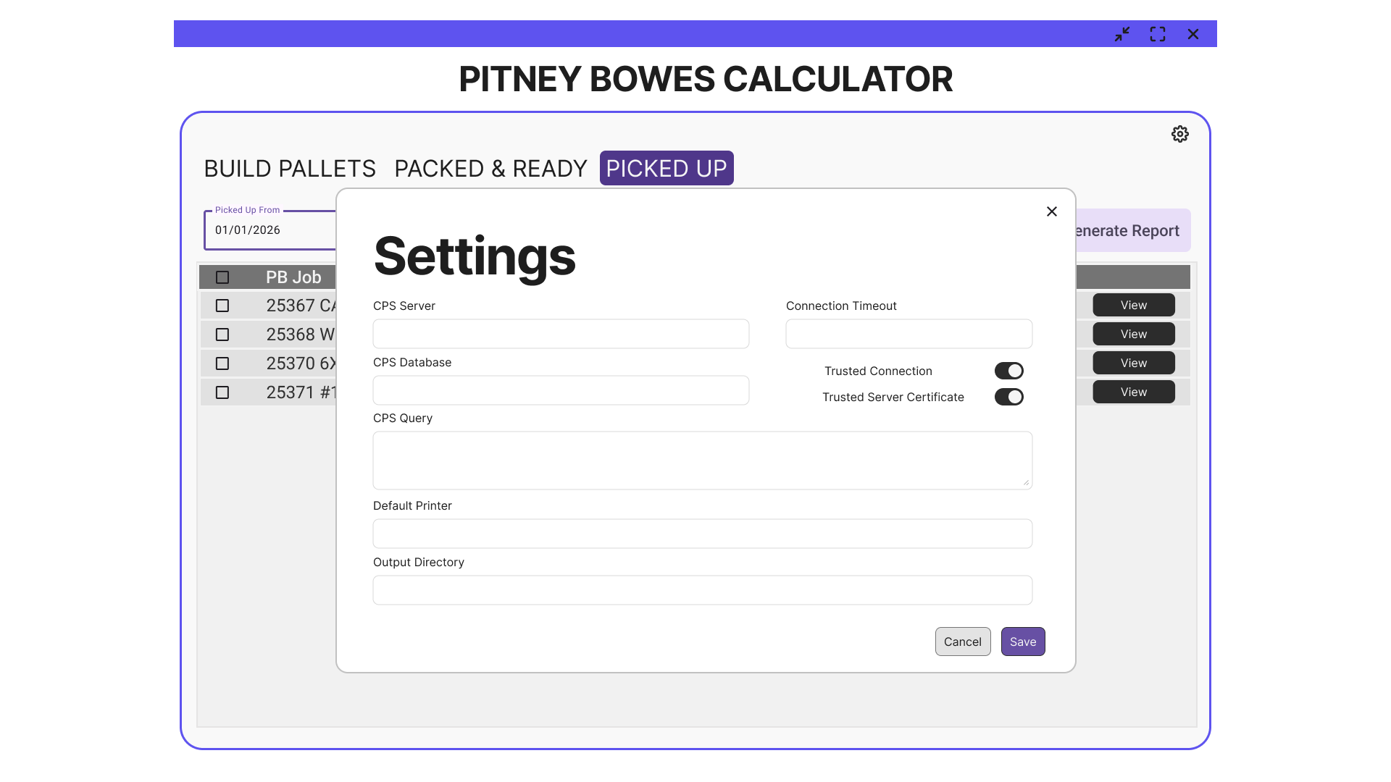
Notes:
Settings Interface

